Slide 1
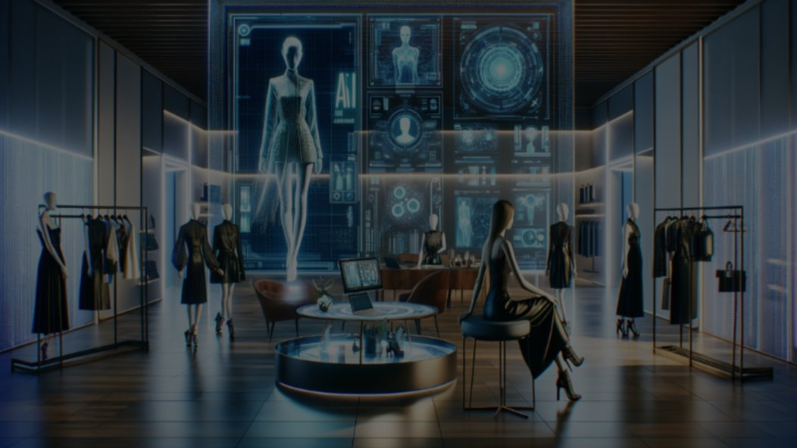


RAJEEV INSTITUTE OF TECHNOLOGY,
HASSAN
DEPARTMENT OF INFORMATION SCIENCE AND ENGINEERING
PROJECT PHASE 2 PRESENTATION
ONLINE CLOTHING RECOMMENDATIONS AND VIRTUAL TRIALS USING AI
PRESENTED TO :
Ms. SINDHU JAIN A M
ASSISTANT PROFESSOR,
DEPT. OF ISE,
RIT, HASSAN
PRESENTED BY :
ANUSHA K (4RA21IS005)
TANUSHREE N (4RA21IS050)
THUSHARA K (4RA21IS052)
VARALAKSHMI D R (4RA21IS054)

Slide 2

CONTENTS
ABSTRACT
INTRODUCTION
LITERATURE SURVEY
PROBLEM STATEMENT
EXISTING SYSTEM
PROPOSED SYSTEM
SOFTWARE REQUIREMENTS
METHODOLOGY
IMPLEMENTATIONS
SNAPSHOTS
BENEFITS
RESULTS AND DISCUSSIONS
CONCLUSION
REFERENCES

Slide 3
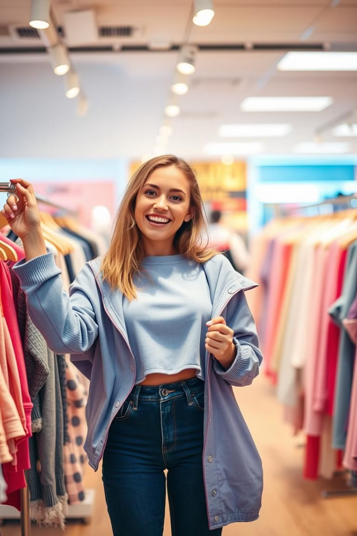
ABSTRACT
This system uses machine learning and collaborative filtering to recommend fashion items based on a user's preferences and style. It also uses advanced body shape prediction to improve accuracy. With the help of computer vision, users can see how clothes will look on them in real-time. The system overlays outfits onto their photos or avatars, creating a realistic visual representation. This provides a better shopping experience by allowing users. The AI analyzes the user's body shape and the clothing's properties, such as how it drapes or fits, to give a more accurate idea of how the outfit will look when worn.

Slide 4

INTRODUCTION
Advanced AI technologies allow you to "try on" clothes virtually using augmented reality (AR) or digital avatars, giving a real-time preview of how garments will look on you.
AI makes online shopping easier by providing size recommendations, thus fitting better, and less hassle of returns.
AI helps users make smarter choices by exploring eco-friendly options and reducing fashion waste through smarter purchasing decisions.

Slide 5
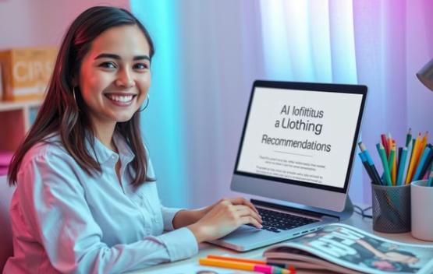
LITERATURE SURVEY
S.I. No. | TITLE | AUTHOR | ABSTRACT | PUBLISHED YEAR
1. | Fashion Recommendation Systems | Dr. B. Nagaraja Naik | This research introduces a fashion recommendation system combining collaborative filtering and deep learning to provide personalized outfit suggestions based on user behavior and preferences | 2024
2. | Study of AI-Driven Fashion Recommender Systems | Shaghayegh Shikharni | This paper proposes a fashion recommendation system enhances user satisfaction, engagement, and platform revenue in the e-commerce fashion industry. | 2023
3. | Virtual Fitting Room and AI based online cloth store | Jayawardhana | In recent years with the pandemic (COVID-19), E-commerce markets have had a boom all over the globe. Even though E-commerce has made purchasing goods and services easier, the existing literature review depicts that most of the customers are not satisfied with the product they receive. | 2022
literature survey

Slide 6
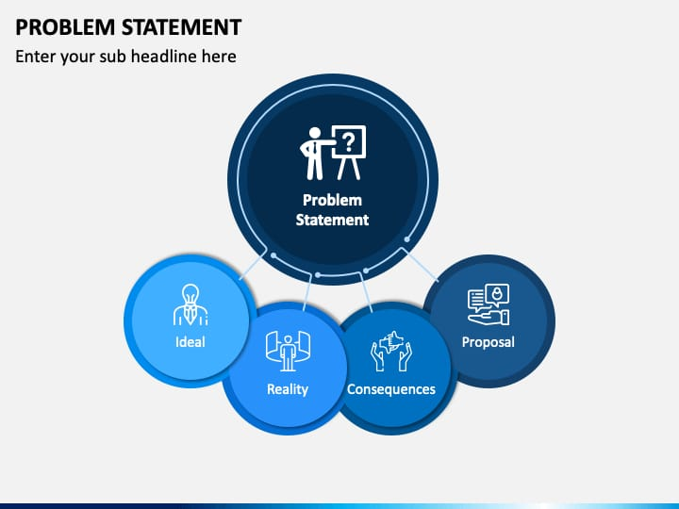

The problem is that when people shop for clothes online, they often find it difficult to visualize how the clothes will look on them. Without trying them on, they may be unsure about the style, fit, or overall appearance, which can lead to hesitation in purchasing.

Slide 7

EXISTING SYSTEM
The current online fashion shopping systems, though convenient, struggle to meet the diverse needs and expectations of consumers. Traditional e-commerce platforms primarily rely on static images, text-based descriptions, and basic filtering mechanisms, which lack the sophistication needed for personalized and interactive shopping experiences. Generic recommendation algorithms

Slide 8
PROPOSED SYSTEM
Our proposed system enhances user experience by making online shopping more interactive, reducing uncertainty about fit.
Advanced Virtual Try-On with 3D Fitting:
Users can see how clothes fit on customizable 3D avatars or themselves in real-time.
Smart Fabric and Fit Analysis:
Users get suggestions on whether the outfit will be tight, loose, or comfortable based on body shape.
Integration of AR/VR Technologies:
Allows users to try on clothes using AR mirrors or VR environments for an immersive shopping experience.
Reduced Return Rates:
With accurate AI-based recommendations and try-on features, return rates are minimized, improving customer satisfaction and reducing operational costs.

Slide 9

SOFTWARE REQUIREMENTS
Backend Framework: Python, flask, django
Frontend: HTML, CSS, JavaScript
(for UI/UX)
Database: PostgreSQL or Mysql

Slide 10
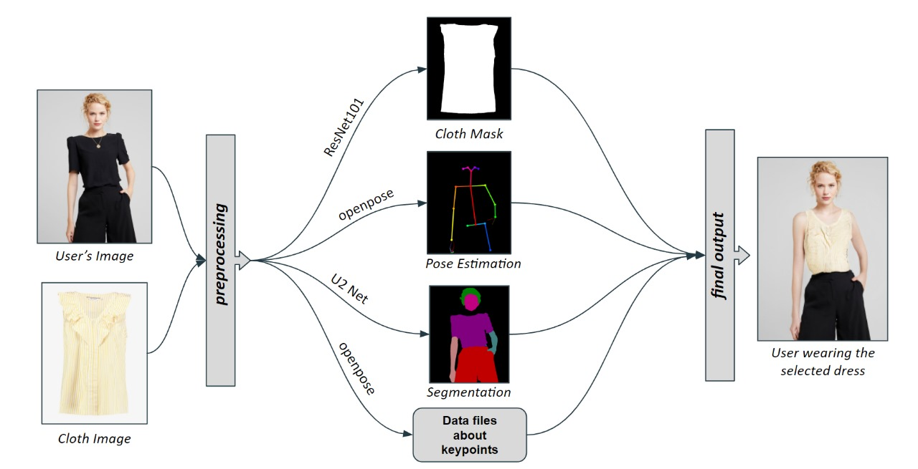











METHODOLOGY
Flow of project

Slide 11
IMPLEMENTATIONS
Phase 1
1
Collect and analyze data from user activities and external sources such as fashion trends and seasonality.
2
Phase 2
Implement AR to enable users to visualize how clothes will look on their body by overlaying garments onto their image in real time.
Phase 3
3
Implement AR to enable users to visualize how clothes will look on their body by overlaying garments onto their image in real time.
4
Phase 4
Analyze user body measurements, purchase returns, and feedback to suggest the best-fitting size.
Phase 5
5
Continuously refine algorithms using reinforcement learning to adapt to changing fashion trends and individual preferences.

Slide 12



Capturing 3D Body Scans for Precise Fit Recommendations
3D Body Scanning
Virtual Fitting Rooms
Advanced scanning technologies capture detailed 3D body measurements, providing accurate data for personalized fit recommendations.
Users can create virtual avatars representing their 3D body shapes and try on clothes virtually to assess fit and style.

Slide 13
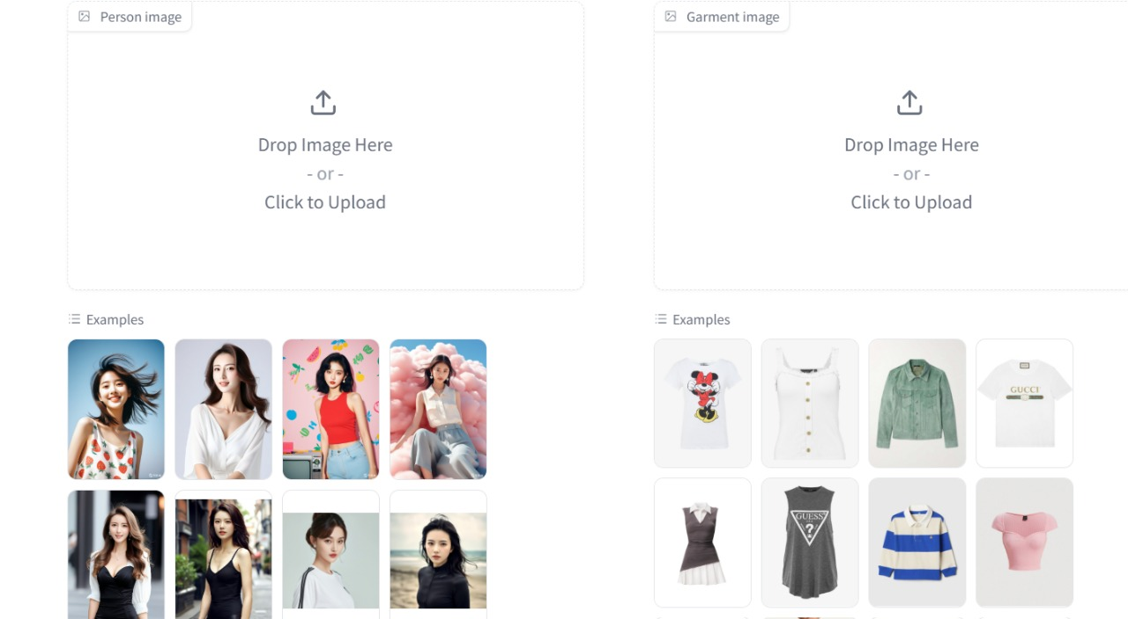
SNAPSHOTS
Snapshot 1: Home Page

Slide 14
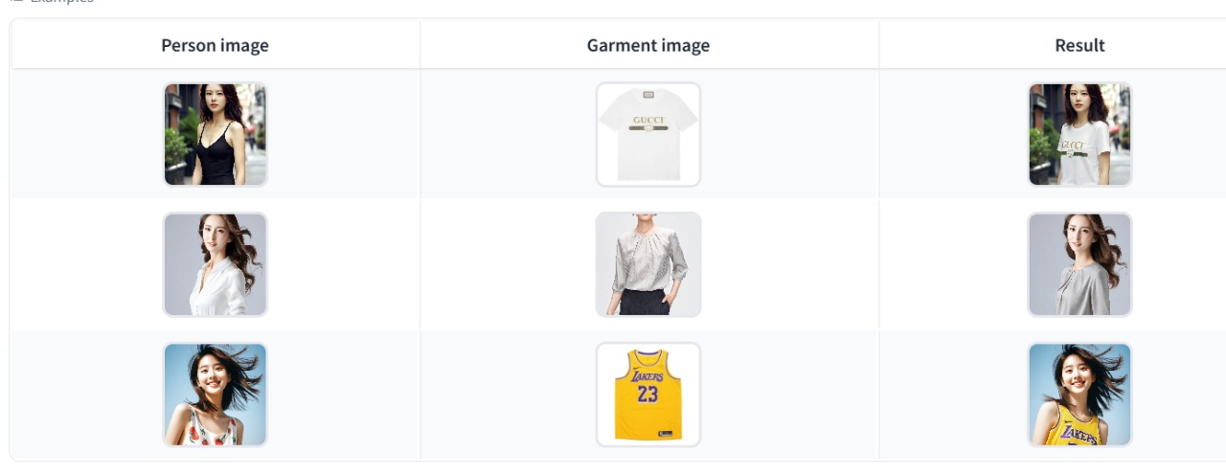

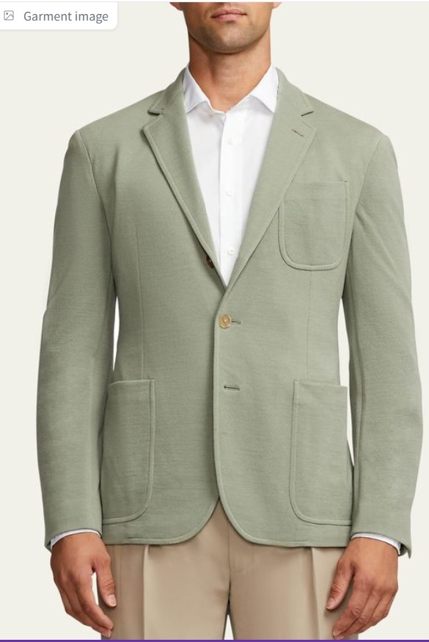

SNAPSHOTS
Snapshot 2: Project flow
==
Snapshot 3: Trial on Men wears

Slide 15
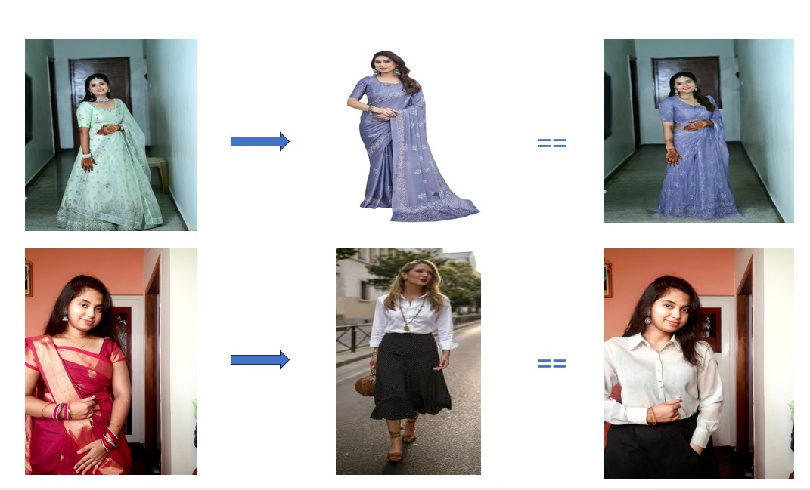
SNAPSHOTS
Snapshot 4: Trial on Saree
Snapshot 5: Trial on Skirt

Slide 16
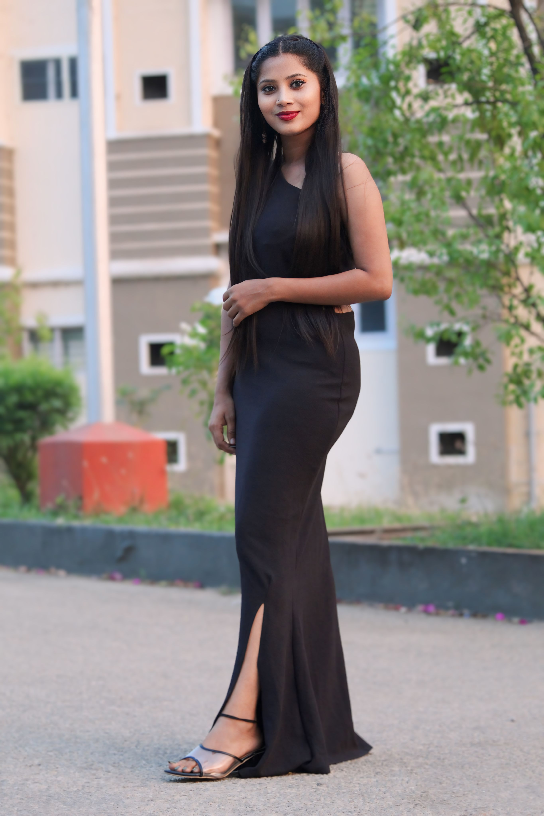
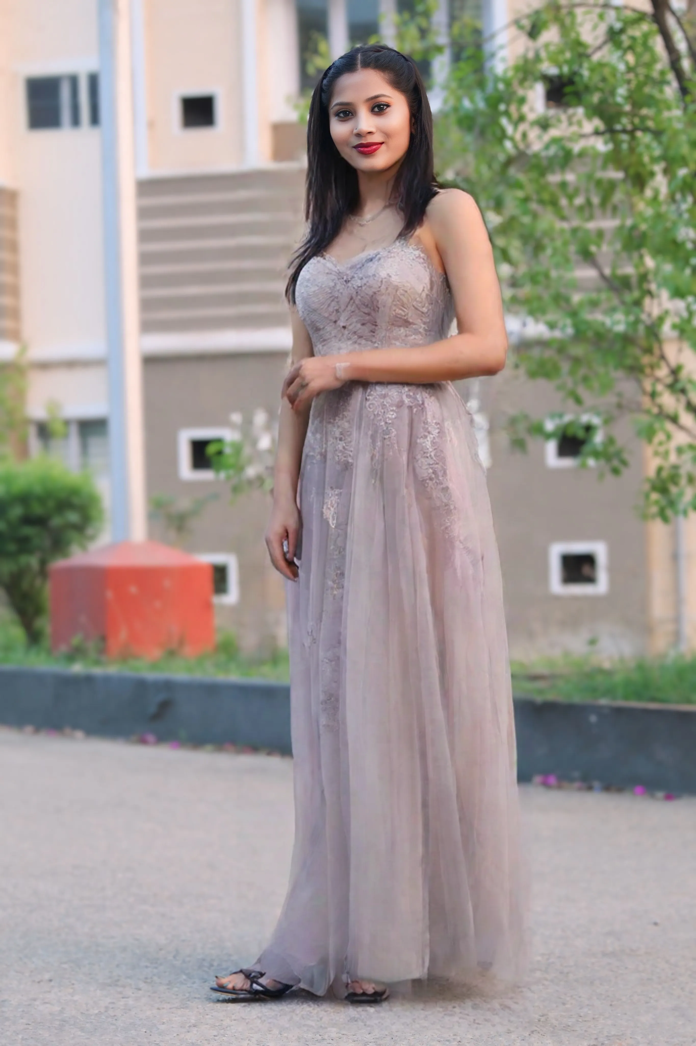
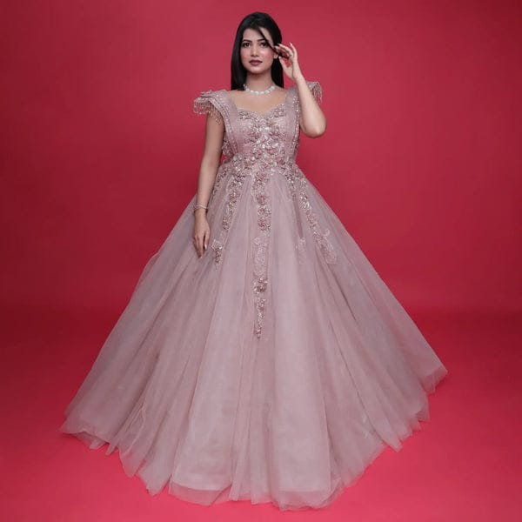


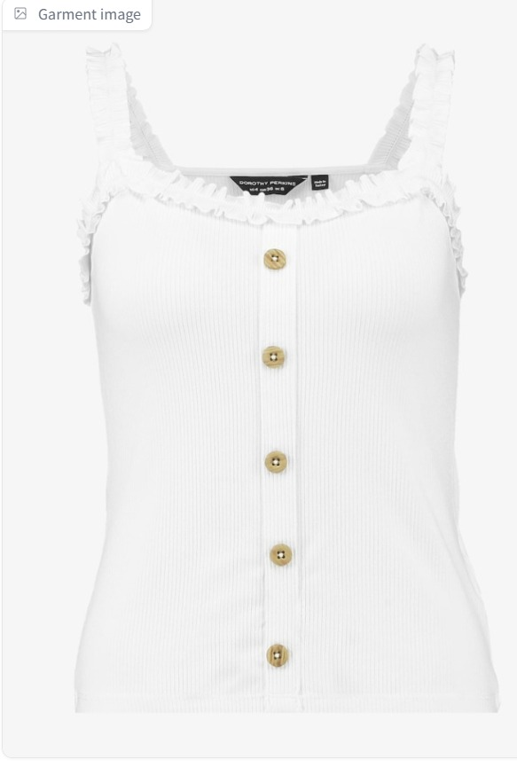
SNAPSHOTS
==
Snapshot 6: Trial on Gown
==
Snapshot 7: Trial on Fancy top

Slide 17





BENEFITS
1
Reduced Returns
2
Improved Fit
3
Increased Satisfaction
4
Personalized Recommendations
5
Virtual Try-On

Slide 18
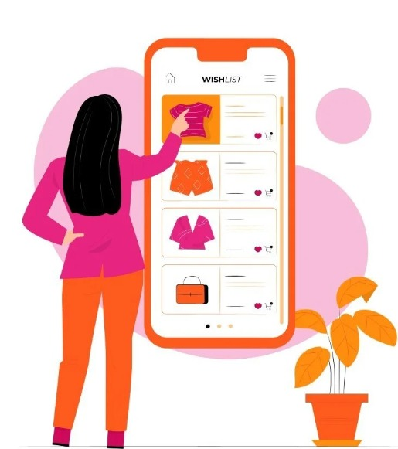
RESULTS AND DISCUSSIONS
AI-driven Style Matching
Body Shape and Size Analysis
Trend Analysis
Real-time Inventory Check
Interactive Feedback
Multi-angle Viewing
Real-Time Recommendations During Trials

Slide 19
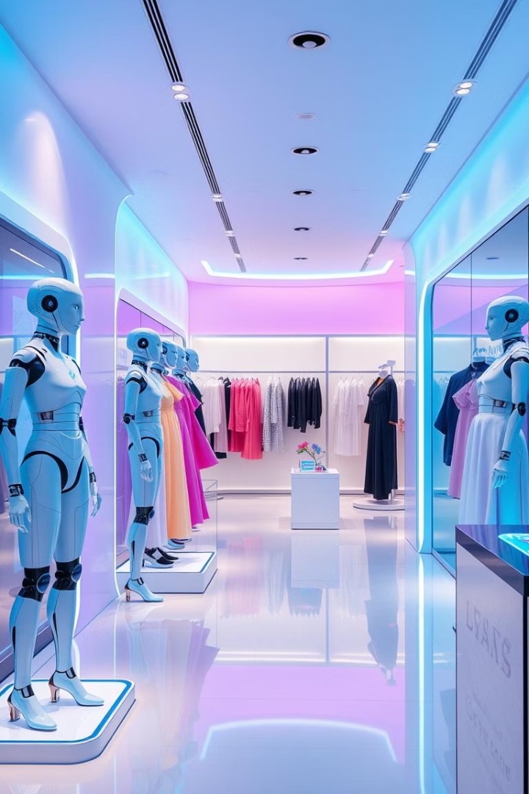
CONCLUSION
Enhanced Shopping Experience: AI-driven online clothing recommendations and virtual trials revolutionize the shopping process by offering personalized, efficient, and engaging experiences for users.
Increased Customer Satisfaction: Accurate size and style predictions reduce return rates, improving customer trust and overall satisfaction.
Efficiency for Retailers: Retailers benefit from better inventory management, targeted marketing, and insights into customer preferences, boosting sales and loyalty.
Future of Fashion: The integration of AI and AR technologies marks a transformative shift in fashion retail, bridging the gap between physical and digital shopping experiences.

Slide 20

CONCLUSION
REFERENCES
[1] S.-S. Weng, "Personalized Product Recommendation in E - commerce," Dep. of Information Management, Fu Jen University, Taipei, Taiwan.
[2] S. H. a. L. Huang, "CLO3D-based 3D virtual fitting technology of Down Jacket and simulation research on dynamic effect of cloth," Wireless Communications and Mobile Computing, p. 1–11, 2022.
[3] S. Chevalier, "Retail e-commerce sales worldwide from 2014 to 2024," Statista, 2022.

Slide 21
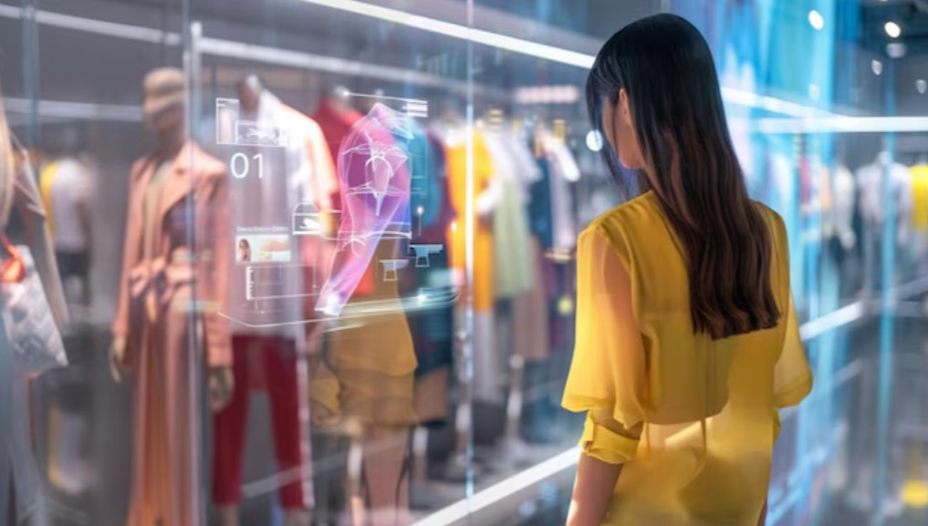
Thank you…!!

